Slide 1
Stochastic Programming with Optimization

Slide 2
Content
Introduction
Example
Basics of Probability
Unconstrained Stochastic Optimization
Nonlinear Stochastic Programming
Two-stage linear Programming
Multi-Stage Linear Programming

Slide 3

Introduction
Many decision problems in business and social systems are modeled using mathematical programs, which seek to maximize or minimize some objective, which is a function of the decisions to be done.
Decisions are represented by variables, which may be, for example, nonnegative or integer. Objectives and constraints are functions of the variables, and problem data.
The feasible decisions are constrained according to limits in resources, minimum requirements, etc.
Examples of problem data include unit costs, production rates, sales, or capacities.

Slide 4
Introduction
Stochastic programming is a framework for modelling optimization problems that involve uncertainty.
Whereas deterministic optimization problems are formulated with known parameters, real world problems almost invariably include some unknown and uncertain parameters.
Stochastic programming models take advantage of the fact that probability distributions governing the data are known or can be estimated.

Slide 5
Introduction
The goal here is to find some policy that is feasible for all (or almost all) the possible data change scenarios and maximizes (or minimizes) the probability of some event or expectation of some function depending on the decisions and the random variables.
This course is aimed to give the knowledge about the statement and solving of stochastic linear and nonlinear programs
The issues are also emphasized on continuous optimization and applicability of programs

Slide 6
Introduction
Applications
Sustainability and Power Planning
Supply Chain Management
Network optimization
Logistics
Financial Management
Location Analysis
Activity–Based Costing (ABC)
Bayesian analysis
etc.

Slide 7
Introduction
An First Example
Farmer Fred can plant his land with either corn, wheat, or beans.
For simplicity, assume that the season will either be wet or dry – nothing in between.
If it is wet, corn is the most profitable
If it is dry, wheat is the most profitable.

Slide 8
Introduction
Sources:
www.stoprog.org
J. Birge & F. Louvaux (1997) Introduction to Stochastic Programming. Springer
L.Sakalauskas (2006)Towards Implementable Nonlinear Stochastic Programming. Lecture Notes in Economics and Mathematical Systems, vol. 581, pp. 257-279

Slide 9
Profit
All Corn All Wheat All Beans
Wet 100 70 80
Dry -10 40 35
Assume the probability of a wet season is p,
the expected profit of planting the different crops:
Corn: -10 + 110p
Wheat: 40 + 30p
Beans: 35 + 45p

Slide 10
What is the answer ?
Suppose p = 0.5, can anyone suggest a planting plan?
Plant 1/2 corn, 1/2 wheat ?
Expected Profit:
0.5 (-10 + 110(0.5)) + 0.5 (40 + 30(0.5))= 50
Is this optimal?

Slide 11
!!!
Suppose p = 0.5, can anyone suggest a planting plan?
Plant all beans!
Expected Profit: 35 + 45(0.5) = 57.5!
The expected profit in behaving optimally is 15% better than in behaving reasonably !

Slide 12
What Did We Learn ?
Averaging Solutions Doesn’t Work!
You can’t replace random parameters by their mean value and solve the problem.
The best decision for today, when faced with a number of different outcomes for the future, is in general not equal to the “average” of the decisions that would be best for each specific future outcome.

Slide 13
Statement of stochastic programs
Mathematical Programming.
The general form of a mathematical program is
minimize f(x₁, x₂,..., x_{n}) - objective function
subject to g₁(x₁, x₂,..., x_{n}) ≤ 0
.. - constraints
g_{m}(x₁, x₂,..., x_{n}) ≤ 0
where the vector
x=(x₁, x₂,..., x_{n}) ϵ X,
supposes the decisions should be done, X is a set that be, e.g., all nonnegative real numbers.
For example, x_{i} can represent production of the i^{th} of n products.

Slide 14
Statement of stochastic programs
Stochastic programming
is like mathematical (deterministic) programming but with “random” parameters. Denote E as symbol of expectation and Prob as symbol of probability.
Thus, now the objective (or constraint) function becomes by mathematical expectation of some random function :
F(x)=Ef(x, ζ),
or probability of some event A(x):
F(x)=Prob(ζ ϵ A(x))
x=(x₁, x₂,..., x_{n}) is a vector of a decision variable, ζ is a vector of random variables, defining the uncertainty (scenarios, outcome of some experiment).

Slide 15

Statement of stochastic programs
It makes sense to do just a bit of review of probability.
ζ ϵ Ω is “outcome” of a random experiment, called by an elementary event.
The set of all possible outcomes is Ω.
The outcomes can be combined into subsets A Ω of ζ (called by events).

Slide 16
Random variable
Random variable ζ is described by
1) Set of support Ω=SUPP(ζ)
2) Probability measure
Probability measure is defined by the cumulative distribution function:

Slide 17
Probabilistic measure
Probabilistic measure has only three components:
  Continuous;
  Discrete (integer);
  Singular.

Slide 18
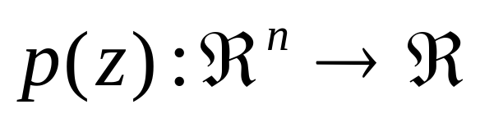
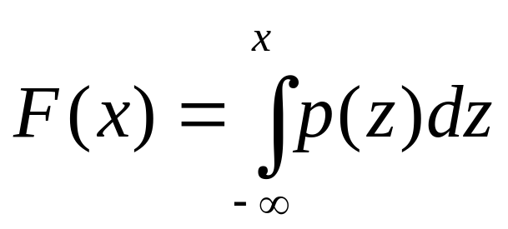
Continuous r.v.
Continuous random variable (or random vector) are defined by probability density function:
Thus, in an uni-variate case:

Slide 19
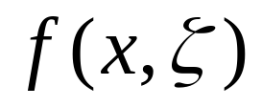
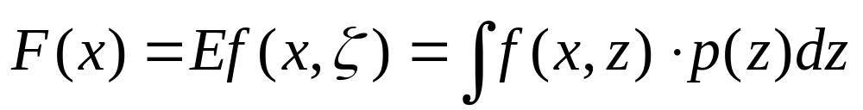
Continuous r.v.
If the probability measure is absolutely continuous, the expected value of random function is integral:

Slide 20
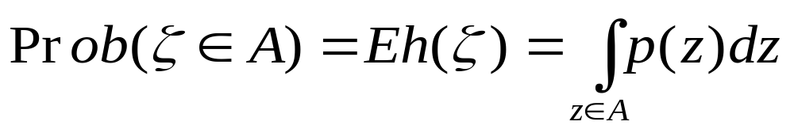
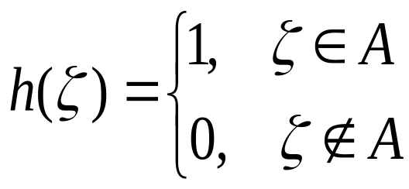
Continuous r.v.
The probability of some event (set of scenarios)
A is defined by the integral, too:
where
is the characteristic-function of set A.

Slide 21
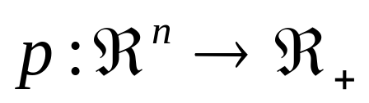
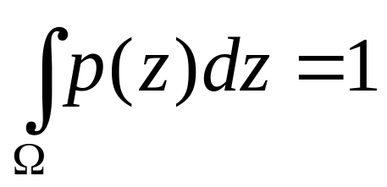
What did we learn ?
Remark. Since any nonnegative function
that
is the density function of certain random variable (or vector) some multivariate integrals can be changed by expectation of some random variable (or vector).

Slide 22
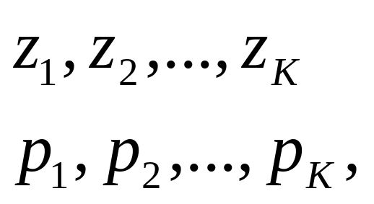
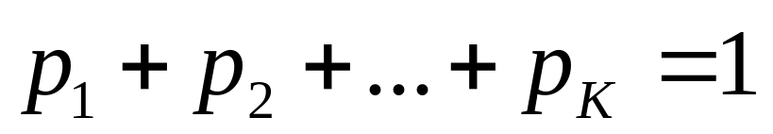
Discrete r. v.
Discrete r.v. ζ is described by mass probabilities of all elementary events:
that

Slide 23
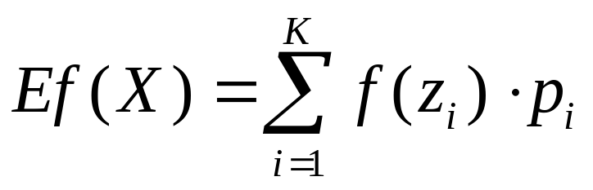
Discrete r. v.
If probability measure is discrete, the expected value of random function is the sum or series:

Slide 24
Singular random variable
Singular r.v. probabilistic measure is concentrated on the set having zero Borel measure (say, Kantor set).

Slide 25
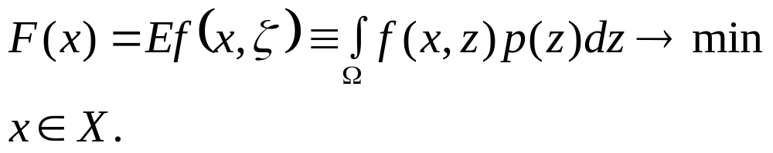
Statement of stochastic programs
Unconstrained continuous (nonlinear) stochastic programming problem:
It is easy to extend this statement to discrete model of uncertainty and constrained optimization

Slide 26
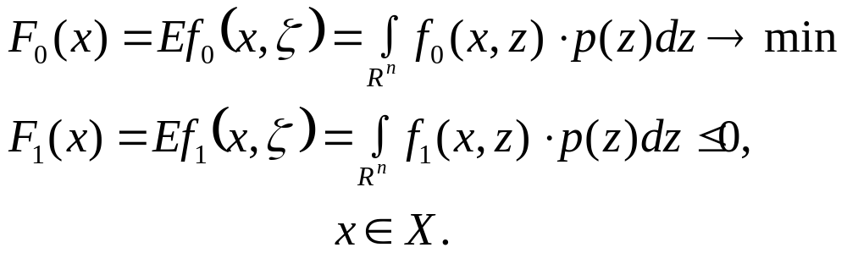
Statement of stochastic programs
Constrained continuous (nonlinear )stochastic programming problem is
If the constraint function is the probability of some event depending on the decision variable, the problem becomes by chance-constrained stochastic programming problem

Slide 27
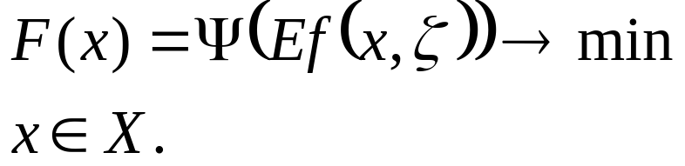
Statement of stochastic programs
Note, the expectation can enter to objective function by nonlinear way, i.e.
Programs with functions of such kind are often considered in statistics: Bayesian analysis, likelihood estimation, etc., that are solved by Monte-Carlo Markov Chain (MCMC) approach.

Slide 28
Statement of stochastic programs
The stochastic two-stage programming.
The most widely applied and studied stochastic programming models are two-stage linear programs.
Here the decision maker takes some action in the first stage, after which a random event occurs affecting the outcome of the first-stage decision.
A recourse decision can then be made in the second stage that compensates for any bad effects that might have been experienced as a result of the first-stage decision.

Slide 29
Statement of stochastic programs
The stochastic two-stage programming.
The optimal policy from such a model is a single first-stage policy and a collection of recourse decisions (a decision rule) defining which second-stage action should be taken in response to each random outcome.

Slide 30
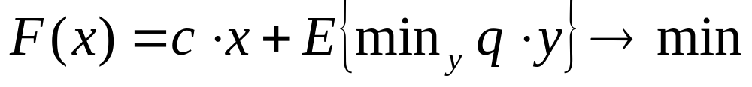



Statement of stochastic programs
two-stage stochastic linear programming
The two-stage stochastic linear programming (SLP) problem with recourse is formulated as
assume vectors q, h and matrices W, T be random in general.

Slide 31
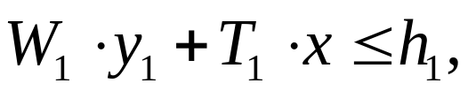
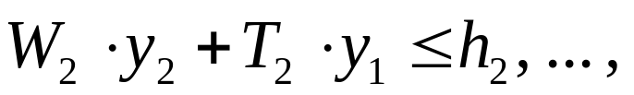


Statement of stochastic programs
      multi-stage stochastic linear programming

Slide 32
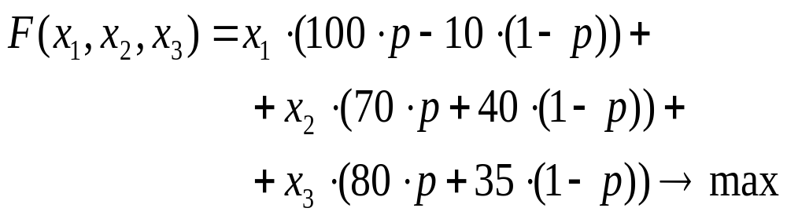
Statement of stochastic programs
An First Example
The Farmer Tedd have solve the optimization problem that to make the best decision:
subject to

Slide 33
Wrap-up and conclusions
Stochastic programming problems are formulated as mathematical programming tasks with the objective and constraints defined as expectations of some random functions or probabilities of some sets of scenarios
Expectations are defined by multivariate integrals (scenarios distributed continuously) or finite series (scenarios distributed discretely).

